Slide 1
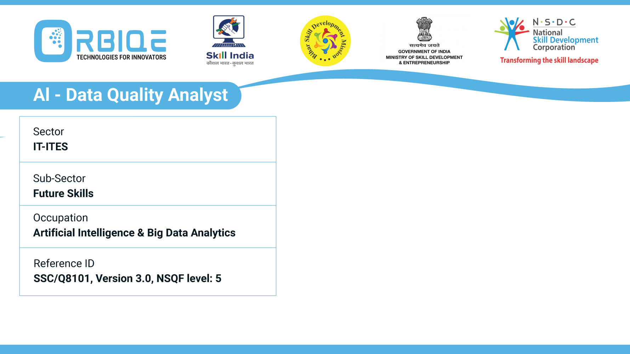
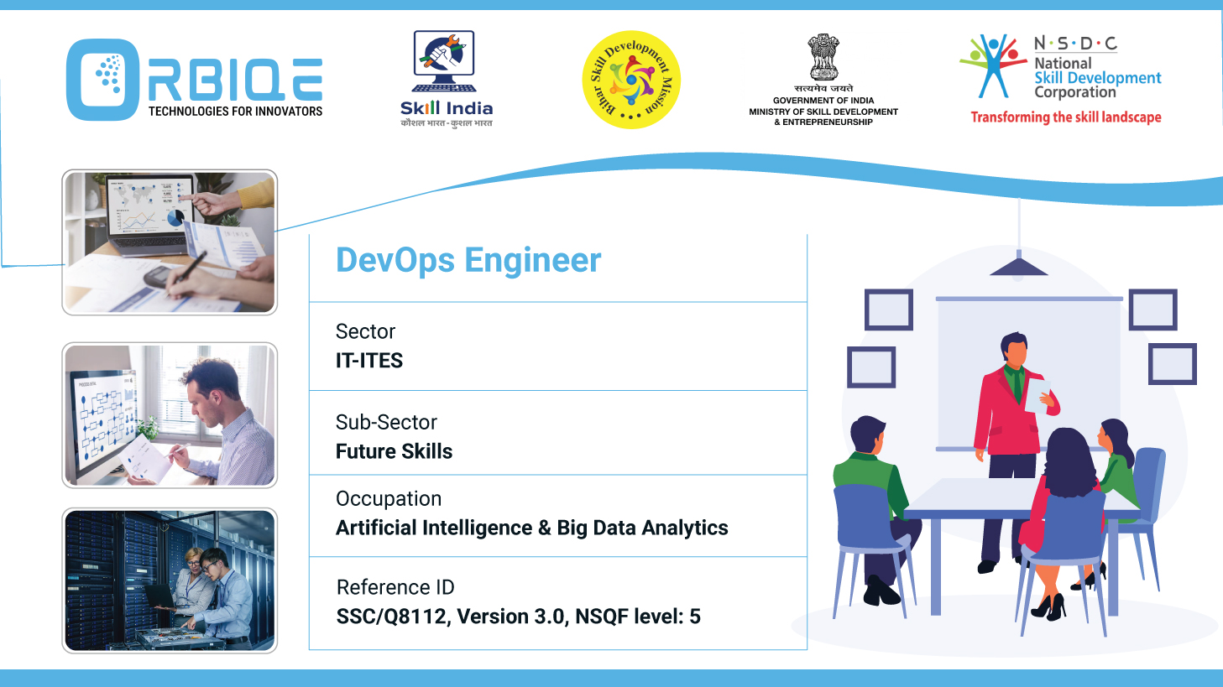
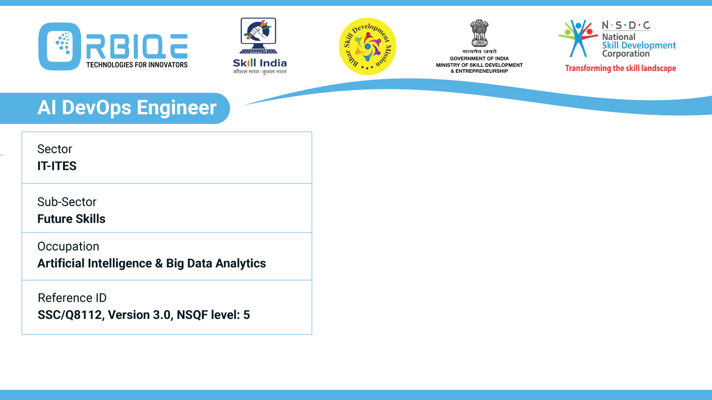
Name- Krishna Kant Dubey

Slide 2

Demonstrate the process of capturing various types of data

Slide 3
Agenda
Capturing Data via a Flask Web Form
Importing Data from Public Databases
Importing Data from Private Databases or Data Stores

Slide 4
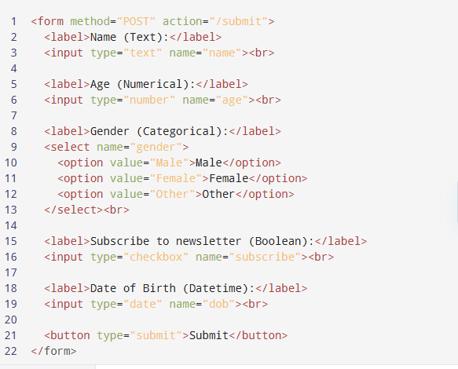
Define the HTML Form

Slide 5
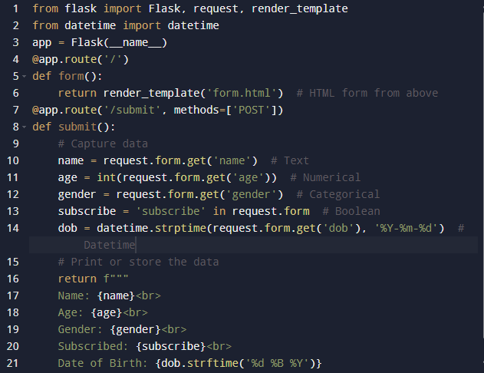
Capture and Process Data in Flask

Slide 6
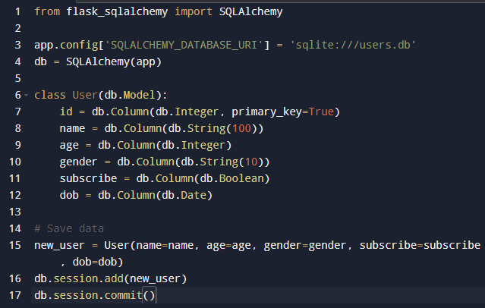
Store in a Database Use SQLAlchemy to store these values in a structured table

Slide 7
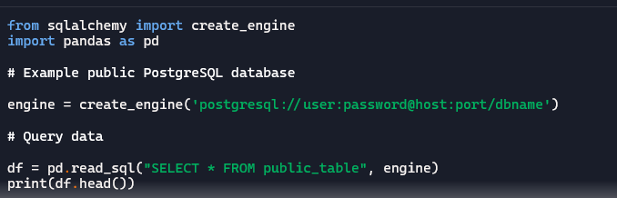
From a Public SQL Database (e.g., PostgreSQL)

Slide 8
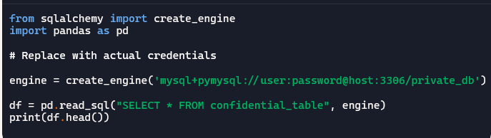
From a Public API (e.g., OpenWeather, World Bank)

Slide 9
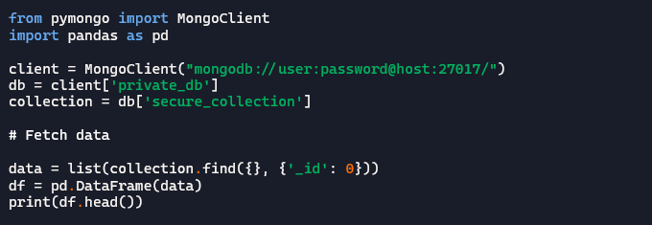
From a Private NoSQL Database (e.g., MongoDB)

Slide 10
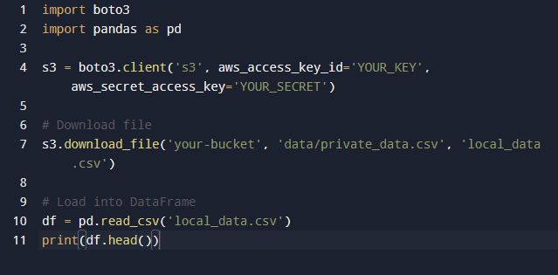
From AWS S3 (Private Data Store)

Slide 11
Thank You

